Slide 1
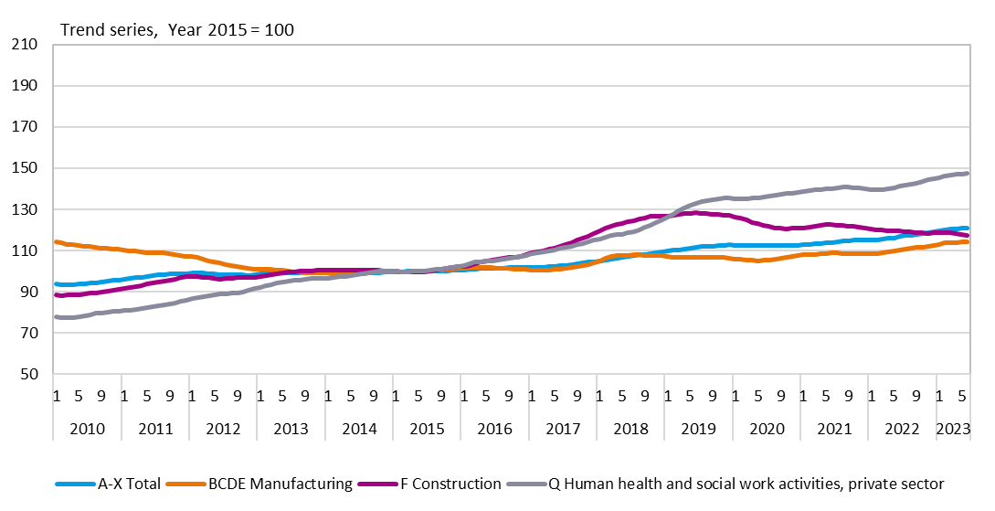
Personnel by sector in the Oulu region, 1/2010–6/2023 Trend series, Year 2015 = 100
Source: Statistics Finland

Slide 2
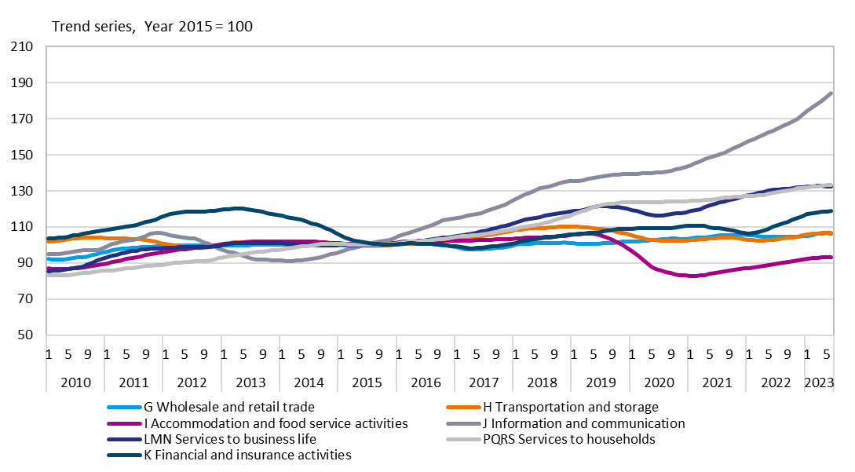
Personnel by sector in the Oulu region, 1/2010–6/2023 Trend series, Year 2015 = 100
Source: Statistics Finland

