Slide 1
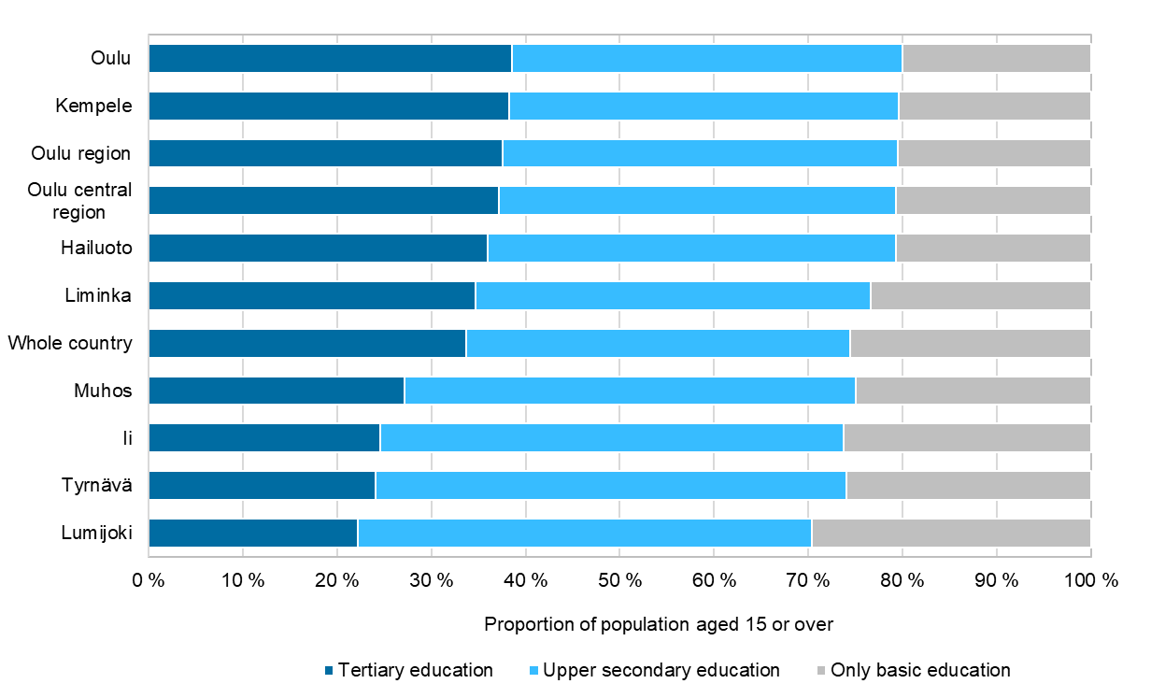
Population aged 15 or over by level of education at end-2022
Source: Statistics Finland

