Slide 1
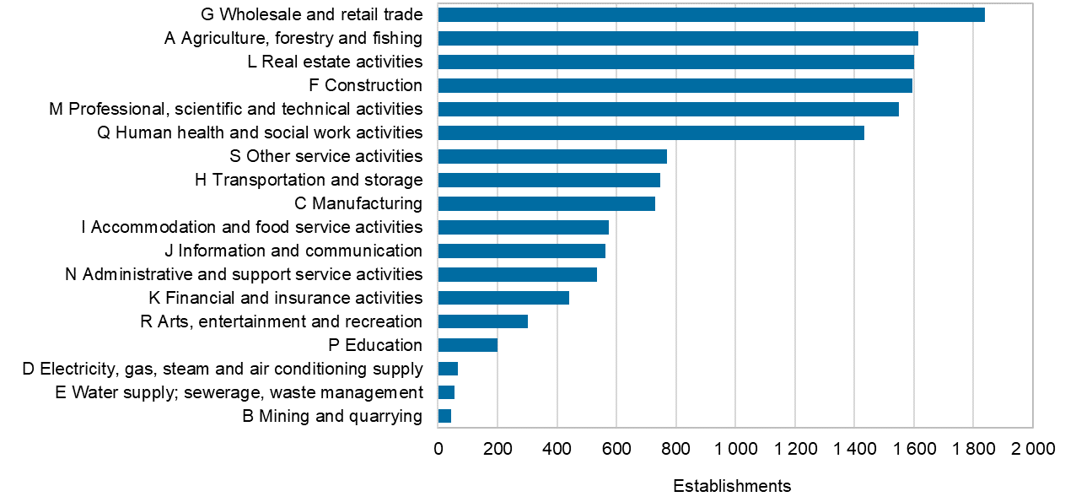
Establishments by industry in the Oulu central region, 2021
Source: Statistics Finland

